Slide 1
Estero Town Center CPD – Tract B, Phase 2 Commercial Planned Development (CPD) Amendment October 23, 2019 Design review board

Slide 2
Project Team
BravoFlorida, LLC – Applicant
Daniel B. Fitzpatrick, CEO
Jennifer Tyler, Vice President of Real Estate & Development
Robin Kendall, Director of Engineering & Design

Slide 3
Aerial Location Map

Slide 4
Aerial of subject property
Aerial Photograph

Slide 5
Approved CPD Master Concept Plan
SUBJECT PARCEL

Slide 6
Project Information
Existing Zoning: Estero Town Center CPD
Project Acreage: 1.4+/- acres (Tract B, Phase 2)
Requests:
1. Cross Section – Add cross-section C-1 to the design standards approved as part of zoning resolution 03-032.
2. Parking – Relief from LDC section, 34 – 2020, required parking spaces, which requires parking spaces at a ratio of 13 spaces 1000 square feet of floor area for fast food restaurants, to permit on-site parking at a ratio of 10 spaces per 1000 square feet for fast food restaurants.
3. Drive-Thru Stacking – Relief from LDC section 34 – 2021, drive-thru stacking requirements, which requires restaurants to provide stacking to accommodate 10 cars per service lane with a minimum of 5 spaces preceding the menu board, to permit the drive-thru restaurant to provide a total of 7 spaces preceding the menu board for the double – drive – thru and a total of 15 spaces in the two service lanes.

Slide 7
Cross sections c & c-1
Approved Z-03-032
Proposed

Slide 8
Site plan
Proposed Site Plan (Tract B, Phase 2)

Slide 9
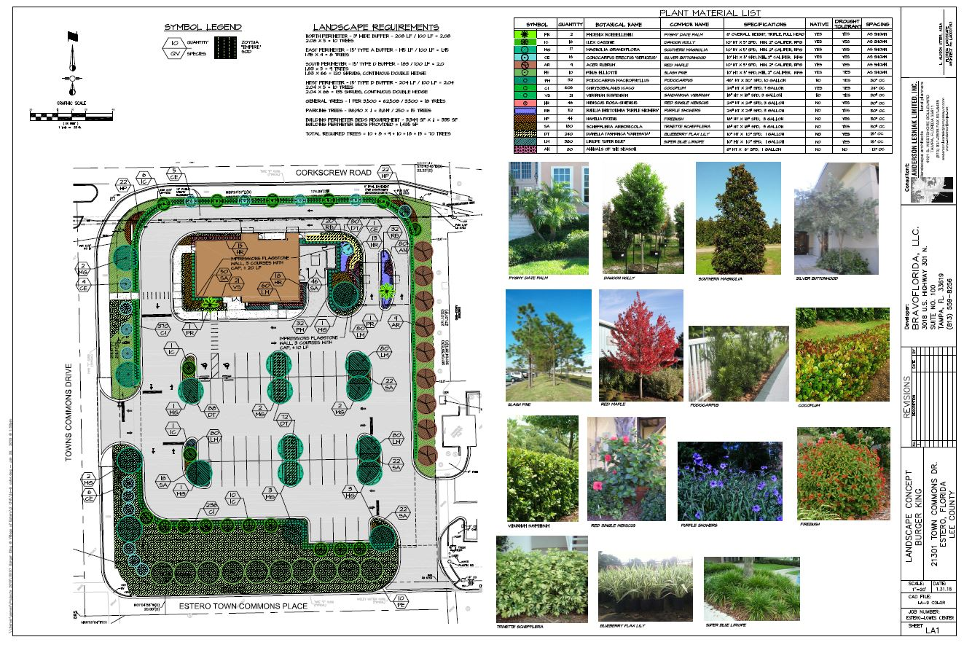
Example of landscape plan

Slide 10
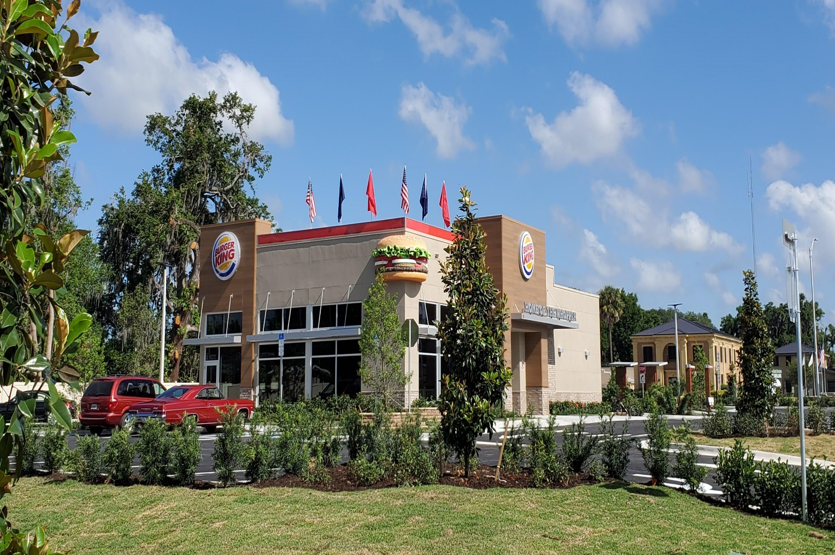
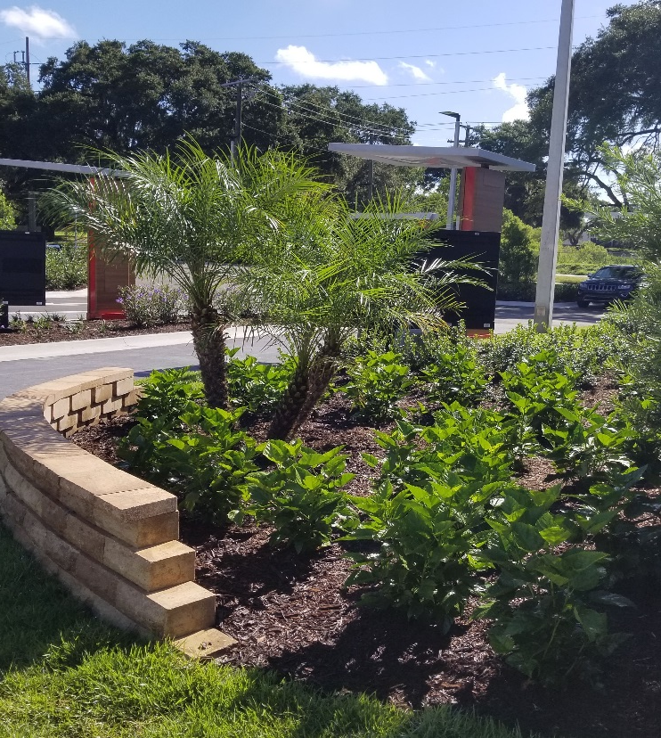
Examples of landscaping

Slide 11
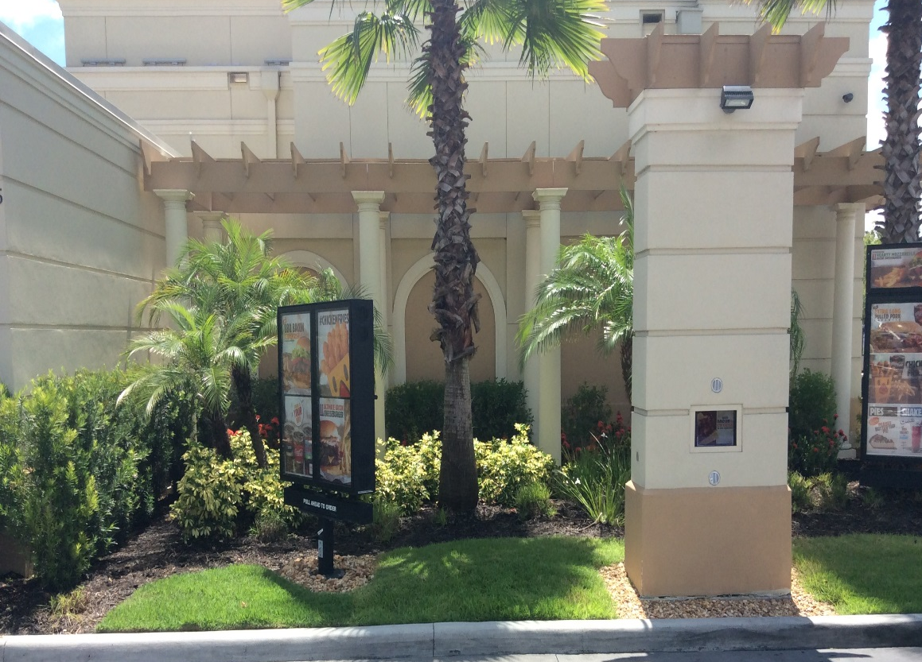
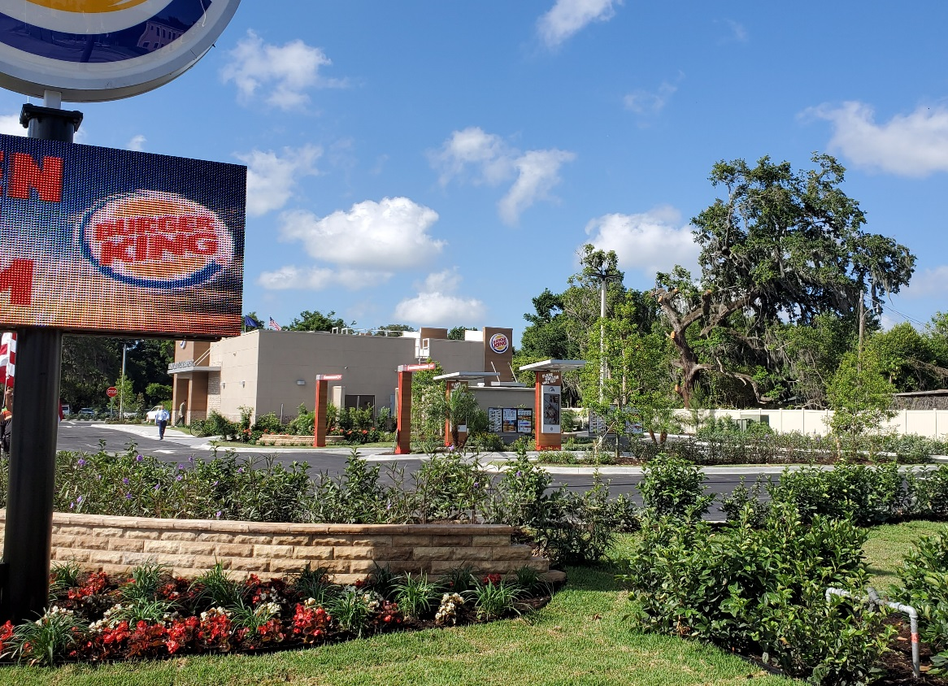
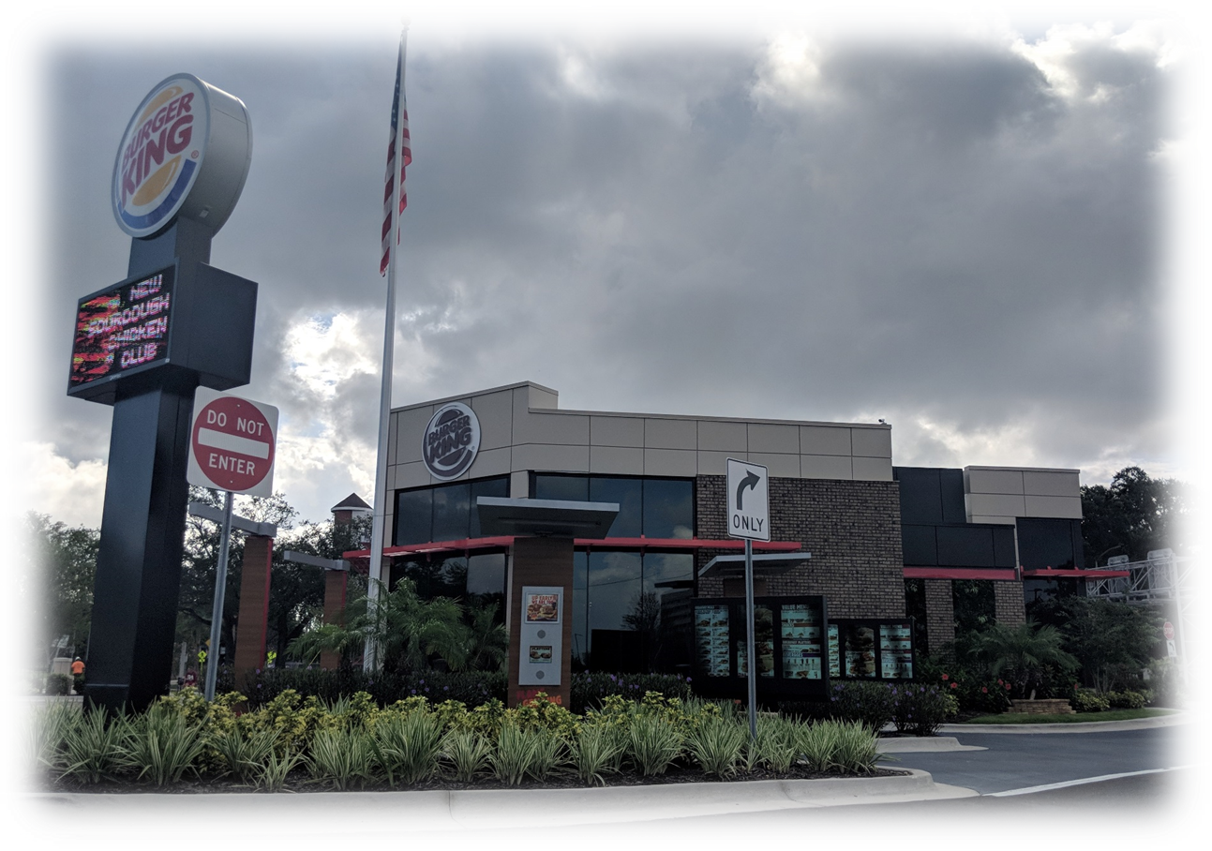
Examples of landscaping

Slide 12
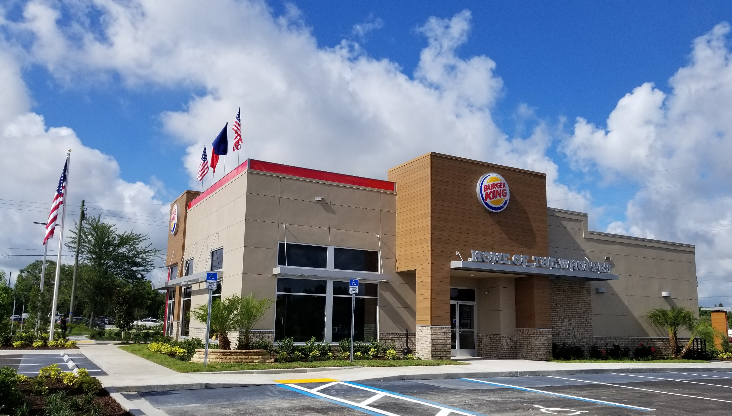
Typical Burger King Restaurant

Slide 13
Proposed Elevations

Slide 14
Proposed Elevations

Slide 15
Proposed Elevations

Slide 16
Lowes and Burger King elevations

Slide 17
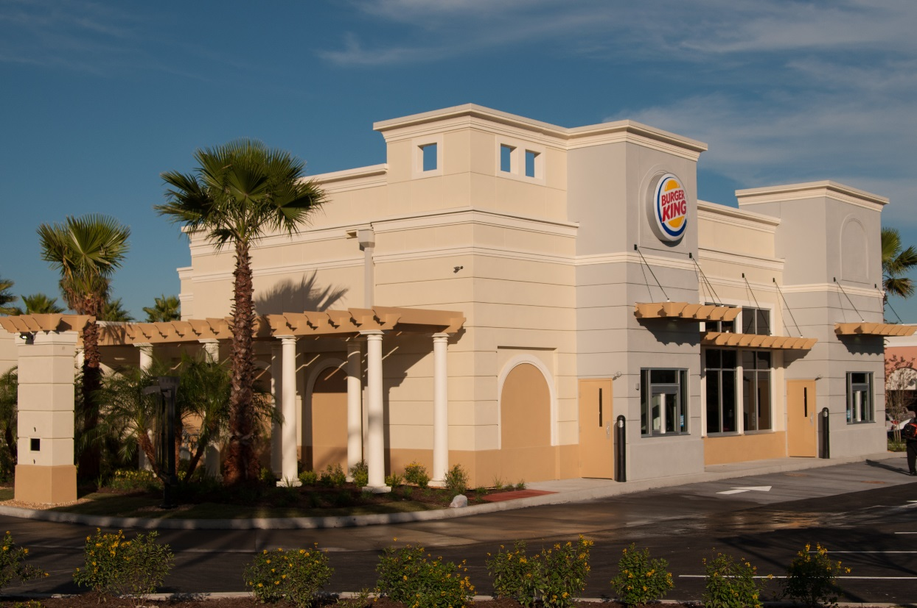
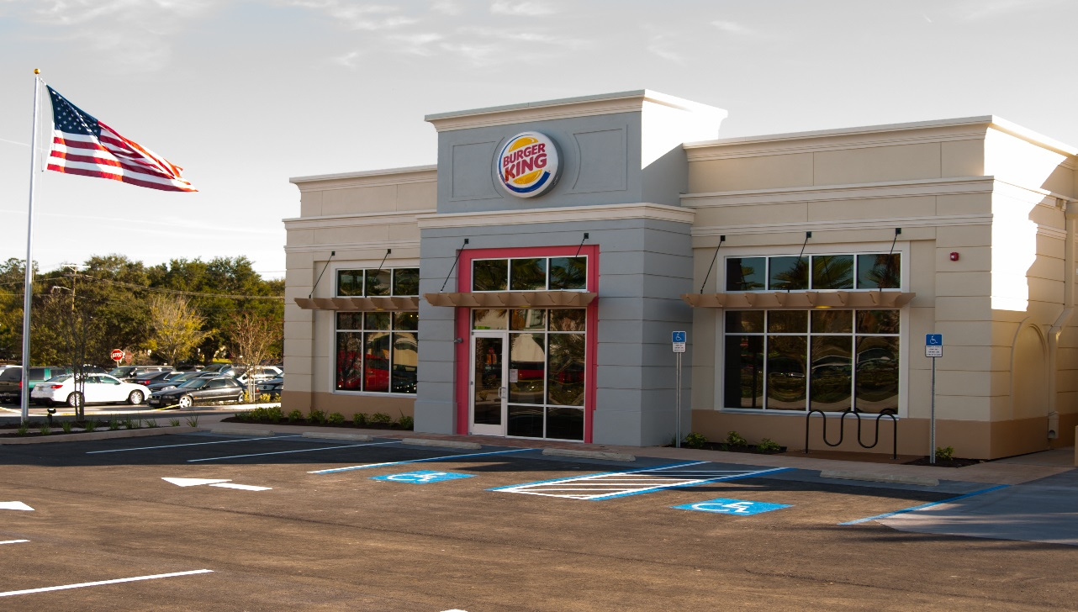
Temple Terrace

Slide 18
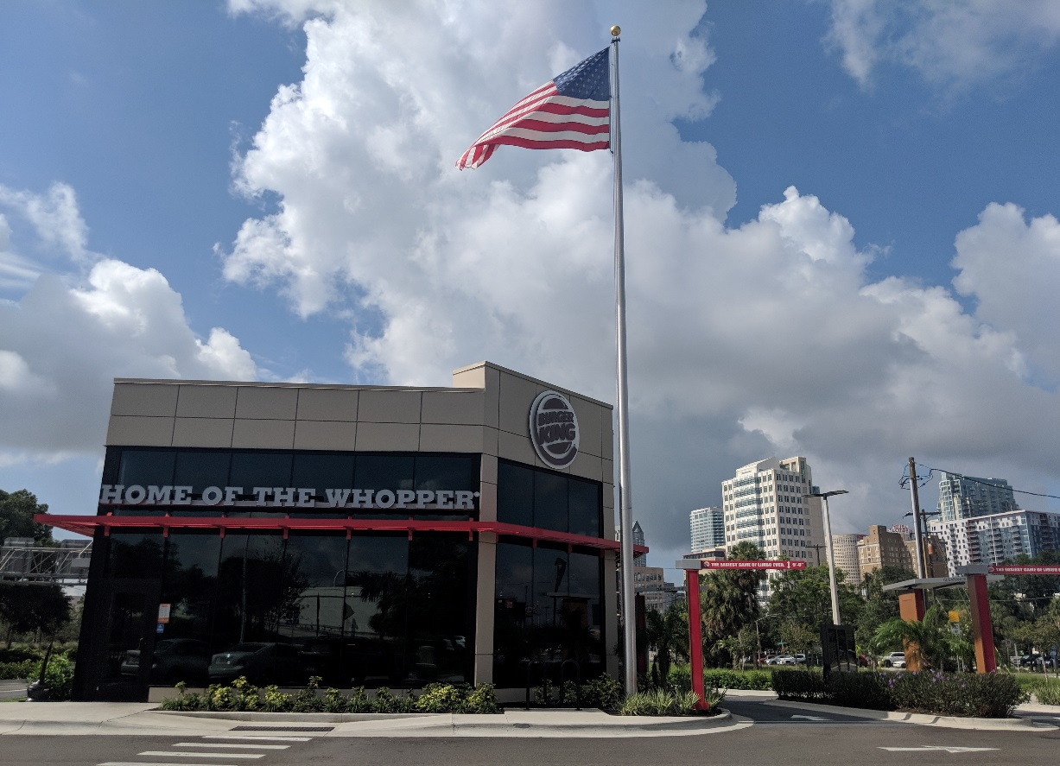
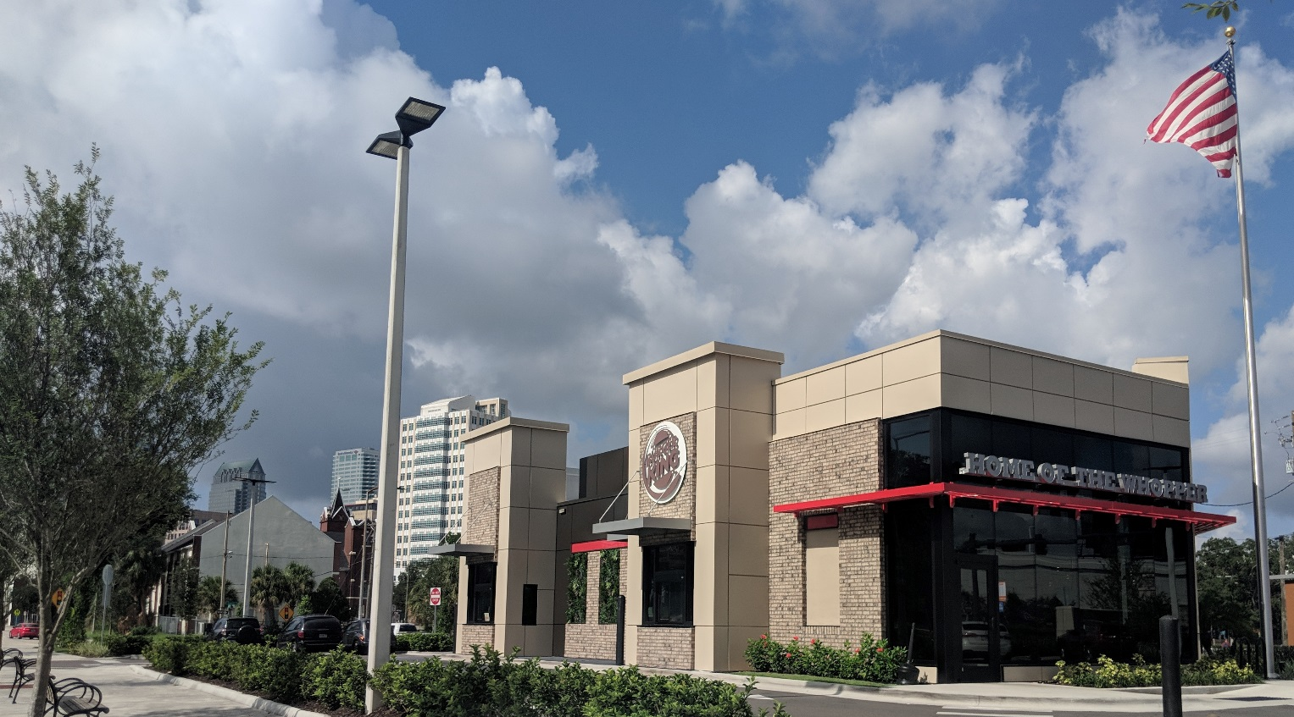
Downtown Tampa

Slide 19
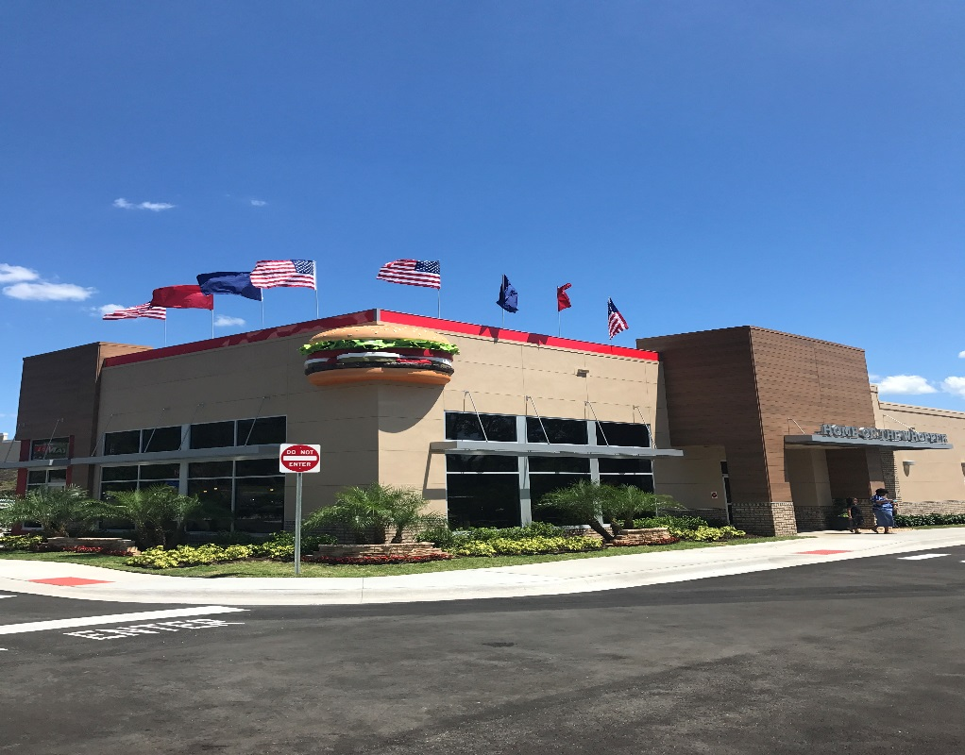
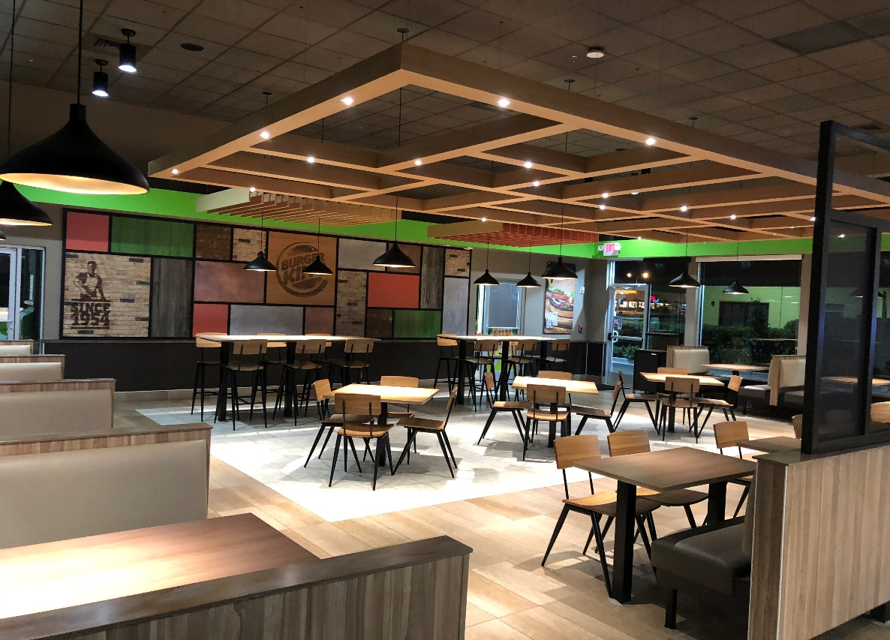
Gainesville

Slide 20
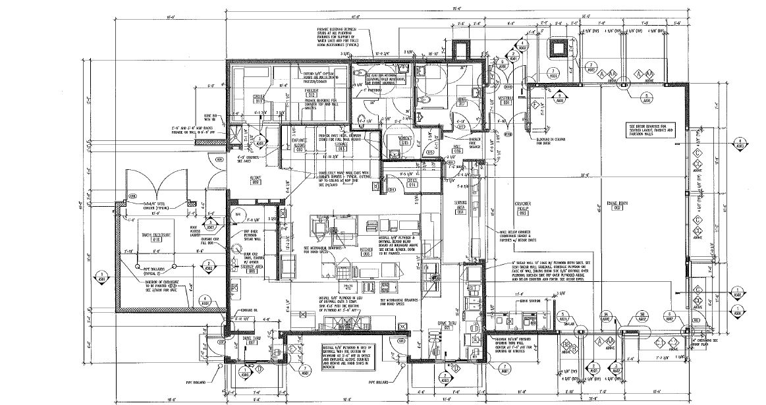
Typical floor plan

Slide 21
Conclusion
The Burger King is an allowable use per the current zoning.
Bravoflorida is requesting:
Approval to add cross-section C-1 which allows for additional landscape buffer along Corkscrew Rd.
Relief from the required parking of 13 spaces per 1,000 sq. ft. of floor area to 10 spaces per 1,000 sq. ft. of floor area. (44 spaces are required, 35 are provided for a reduction of 9 spaces. A parking study has been provided to City Staff with a recommendation for approval.
Relief from the required drive thru stacking to accommodate 5 spaces proceeding the menu board for each lane for a total 10 space to 7 spaces provided. A queuing study has been provided to City Staff with a recommendation for approval.

Slide 22
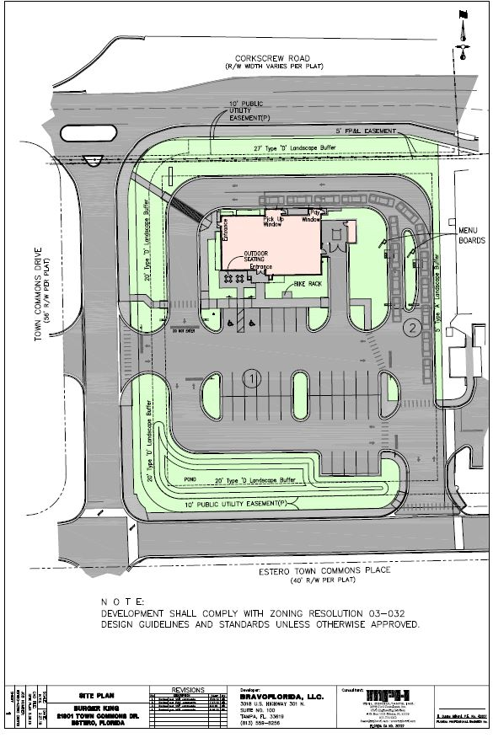
Thank You

