Slide 1
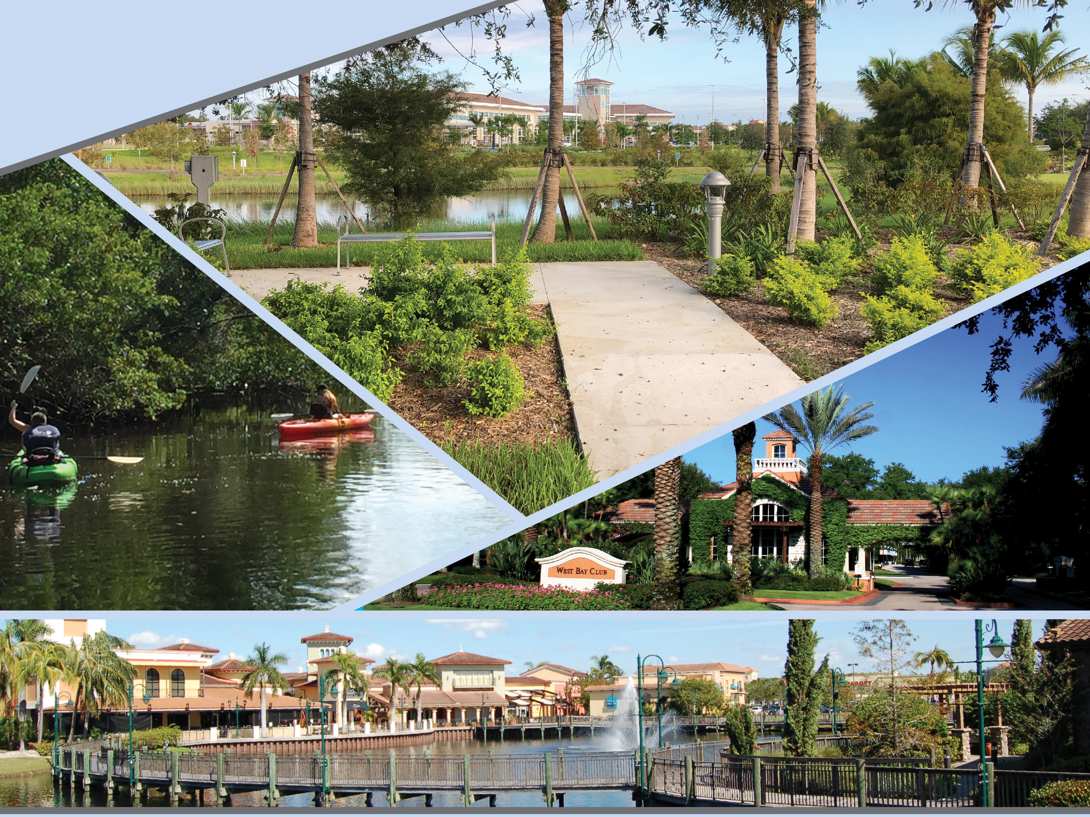
Land Development Code
Planning & Zoning Board
October 2020

Slide 2
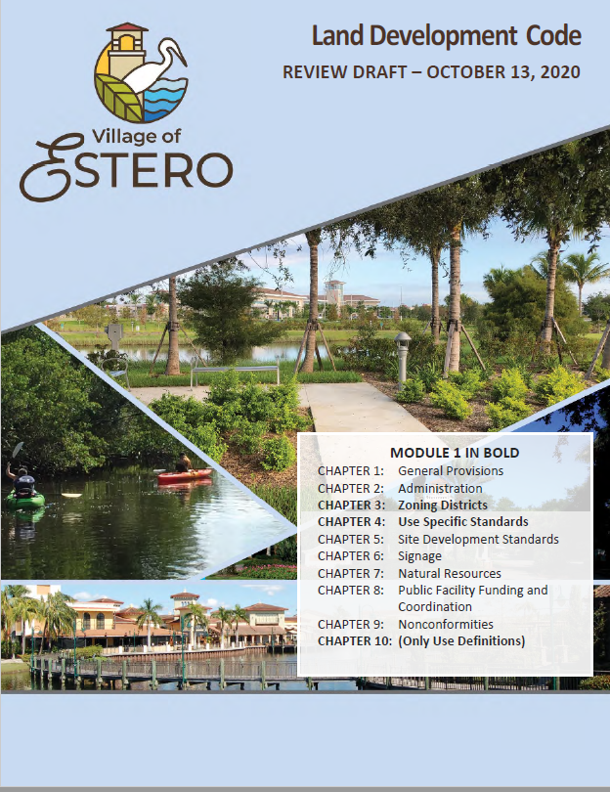
Overview
Background
Code Organization
Review of Zoning Chapters
Next Steps
Questions and Comments
The LDC Module and the Proposed Zoning Map discussed in
this presentation are available to the public at:
https://estero-fl.gov/land-development-code/

Slide 3
Background
Preparation of Land Development Code (LDC)
December 31, 2014
Village of Estero Incorporated
Lee County LDC adopted as transitional LDC
Comprehensive Plan prepared after much work and public input
Officially Approved by State
November 2019
Preparation of new LDC started as Plan approval is completed
Anticipated Adoption
January 2021

Slide 4
Background
What is a Land Development Code?
The Land Development Code regulates development and sets standards for:
Landscaping
Architecture
Parking
Open space and similar items
Zoning rules
How is the LDC different from the Comprehensive Plan?
The Comprehensive plan is a broad long range vision and policy document
The LDC is a technical document with detailed regulations

Slide 5
Chapter 3: Zoning Districts
Modernizes and simplifies the Zoning District structure and also implements the Comprehensive Plan policies
Used transitional LDC as starting point
Based on Plan direction and current conditions:
Consolidates and simplifies some districts
Carries forward a few districts with refinements
Deletes some districts
Adds some new districts
Chapter 3: Zoning Districts
Section 3-1 General Provisions
Section 3-2 Agricultural District
Section 3-3 Residential Districts
Section 3-4 Commercial Districts
Section 3-5 Special Purpose Districts
Section 3-6 Legacy Districts
Section 3-7 Planned Development Districts
Section 3-8 Overlay Districts

Slide 6
Chapter 3: Zoning Districts
Chapter 3: Zoning Districts
Section 3-1 General Provisions
Section 3-2 Agricultural District
Section 3-3 Residential Districts
Section 3-4 Commercial Districts
Section 3-5 Special Purpose Districts
Section 3-6 Legacy Districts
Section 3-7 Planned Development Districts
Section 3-8 Overlay Districts
Districts organized as:
Conventional districts
Legacy districts
Planned development districts
Overlay districts
District standards presented with text and tables
Photos used to further explain development concepts
Use table included with each district in more readable form than in transitional LDC

Slide 7
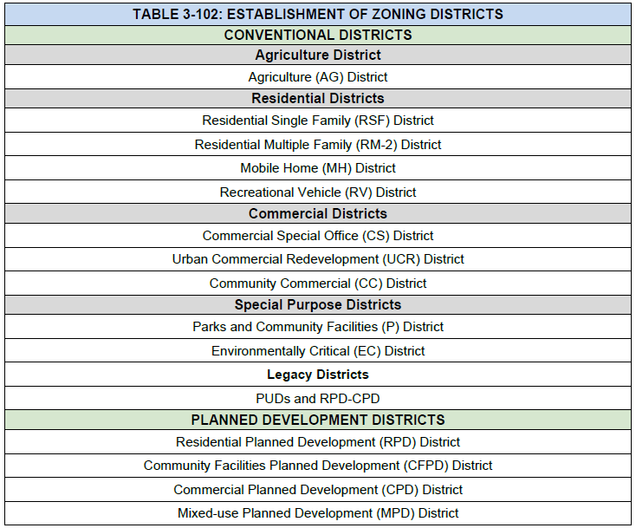
Zoning Districts
New Zoning District Lineup

Slide 8
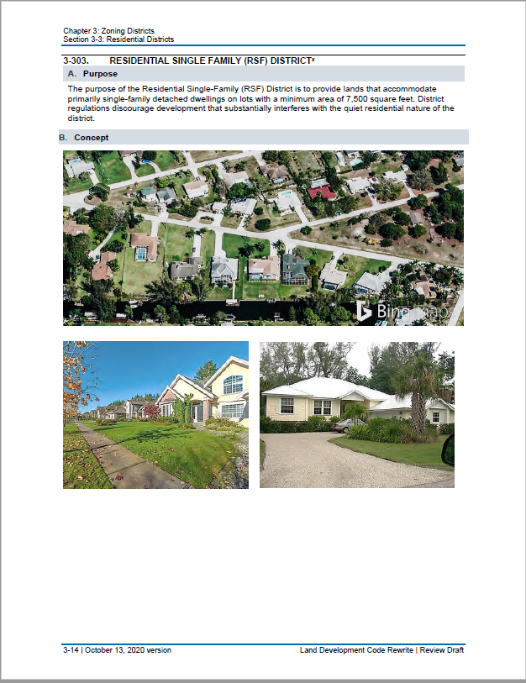
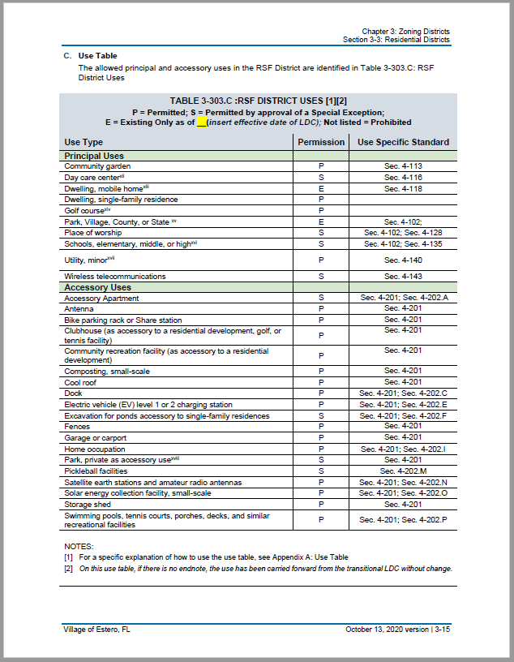
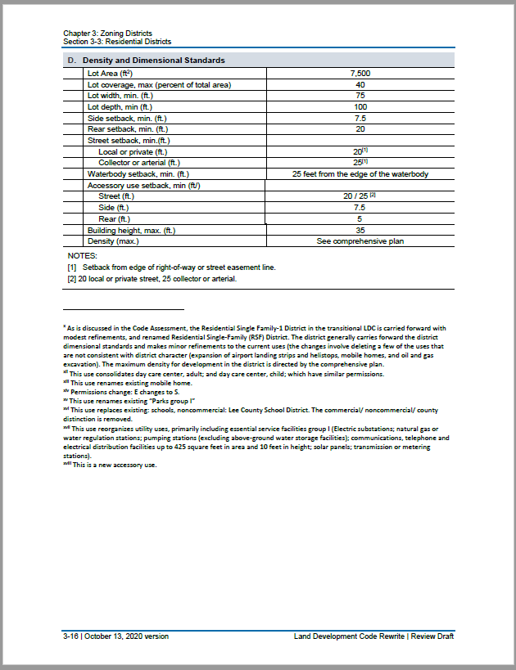
Zoning Districts – Conventional District Structure (Example: Residential Single Family)
Four sections are in every conventional district
A. Purpose; describing the district
B. Concept; helpful aerial or streetside photos
3-303 RESIDENTIAL SINGLE FAMILY (RSF) DISTRICT

Slide 9
Zoning Districts – Conventional District Structure (Example: Residential Single Family)
C. Use Table: Table shows permissions for principal uses and accessory uses, and cross references to standards in Ch. 4
3-303 RESIDENTIAL SINGLE FAMILY (RSF) DISTRICT

Slide 10
Zoning Districts – Conventional District Structure (Example: Residential Single Family)
D. Density and Dimensional Standards; list standards specific to the district
Some districts also have E. Other Standards; which includes other district-specific standards as needed
Footnotes:
help explain and track detailed changes or sources within the document. These will be deleted for the final adopted LDC
3-303 RESIDENTIAL SINGLE FAMILY (RSF) DISTRICT

Slide 11
Chapter 3: Zoning Districts
10 Conventional Districts
One Agricultural District (AG)
Four Residential Districts
RSF (Residential Single-Family)
RM-2 (Residential Multifamily)
MH (Mobile Home)
RV (Recreational Vehicle)
Three Commercial Districts
CS (Commercial Special Office)
UCR (Urban Commercial Redevelopment)
CC (Community Commercial)
Two Special Purpose Districts
P (Parks and Community Facilities)
EC (Environmentally Critical)
Two Legacy Districts
PUDs and RPD-CPDs
Six Planned Development Districts
RPD (Residential PD)
CFPD (Community Facilities PD)
CPD (Commercial PD)
MPD (Mixed-Use PD)
EPD (Estero PD)
CCPD (Compact Community PD)
Three Overlay Districts
Corkscrew Road Overlay
US 41 Overlay
Airport Compatibility Overlay

Slide 12
Chapter 3: Zoning Districts
Highlights
Consolidates current agricultural districts into one district
Consolidates current single family residential districts into one district
Carries forward with no future expansion a mobile home and a recreational vehicle district
Reorganizes the commercial districts replacing the old C-1, renaming the old CS-2, and consolidating the old CC and CG districts
Refines the special purpose districts to have a preservation-focused district and a parks and community facilities primarily public district
Carries forward the current planned development districts, with refinements to implement comprehensive plan direction
Removes districts in transitional LDC that are not used or are irrelevant to development in the Village
Notes:
###Add some detail

Slide 13
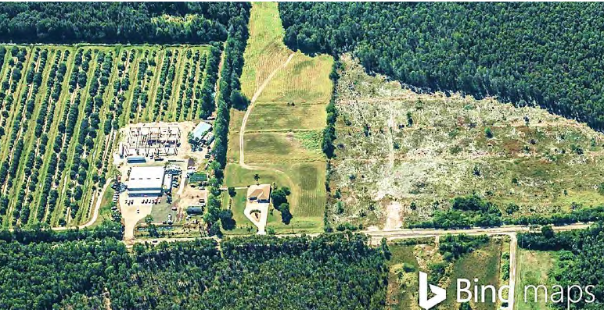
Chapter 3: Zoning Districts Sec. 3-2: Agriculture
Several agricultural districts are consolidated into one.
Agriculture is the primary permitted use while accommodating single family residences and mobile homes at low densities.
Some previously allowed uses inappropriate for the Village (such as keeping of wild animals) are removed.

Slide 14
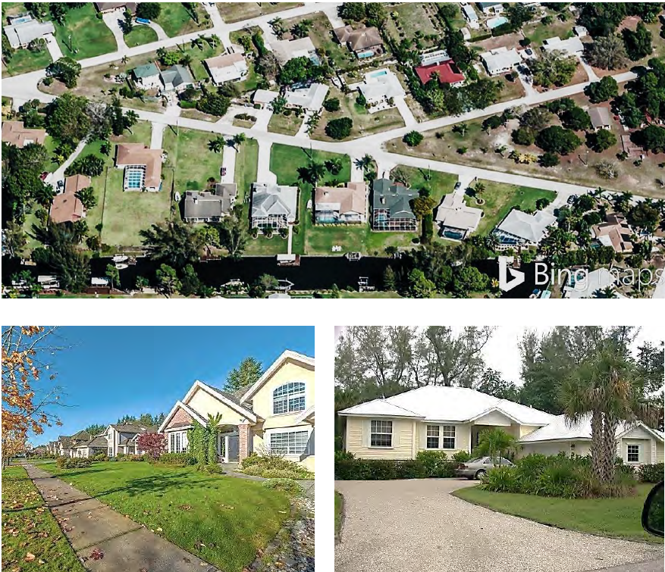
Chapter 3: Zoning Districts Sec. 3-3 Residential
Residential Single Family (RSF)
Four single family districts in transitional LDC consolidated into one district
Minimum lot area 7500 sq. ft.
Uses – single family

Slide 15
Chapter 3: Zoning Districts Sec. 3-3 Residential
Mobile Home (MH) And Recreational Vehicle (RV)
Consolidates the MH and RV districts from transitional LDC into one MH and one RV district
Allows for dimensional standards approved in Lee County Ordinance 86-36 where parks approved under this ordinance still remain
Allows for maintenance and replacement in existing footprint with certain upgrades to improve aesthetics
Residential Multiple Family (RM-2)
Carried forward from transitional LDC
Allows variety of dwelling types (single family, two family, multiple-family, townhouse)
Dimensional standards carried forward from the transitional LDC
Included in the Purpose of each of these districts:
“It is the intent of the Village Council in establishing this district, and applying it to the Official Zoning Map that upon the adoption of this LDC, the [RM-2, MH, or RV] district not be applied to any additional lands in the Village.”

Slide 16
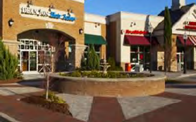
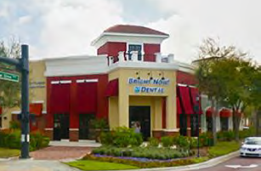
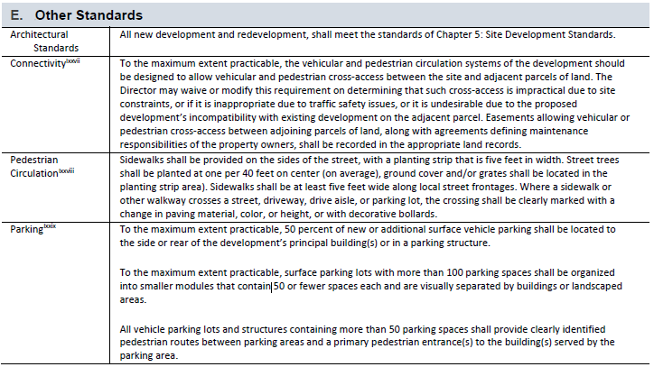
Chapter 3: Zoning Districts Sec. 3-4 Commercial
Urban Commercial Redevelopment (UCR)
Creates a new district replacing C-1
Encourages redevelopment along US41 in the north part of the Village
Allows community and neighborhood-serving commercial uses
Residential and vertical mixed use permitted, including live-work dwelling
No industrial uses allowed
Standards added to improve pedestrian circulation and connectivity
Example:
Connectivity: “To the maximum extent practicable, the vehicular and pedestrian circulation systems of the development should be designed to allow vehicular and pedestrian cross‐access between the site and adjacent parcels of land…”

Slide 17
Chapter 3: Zoning Districts Sec. 3-4 Commercial
Commercial Special Office (CS)
Carries forward CS-2 from the transitional LDC, applied in a very limited area
Uses and dimensional standards generally carried forward from transitional LDC
Community Commercial (CC)
High quality, medium-scale, community-serving commercial development (particularly shopping centers)
Generally carried froward from transitional LDC
Note on commercial development:
All commercial development requiring a rezoning must be through planned development (4-112.A)
Notes:
MG Note: UCR Creates a new commercial zoning district (replaces C-1) encouraging redevelopment along portions of US41 in north Estero.

Slide 18
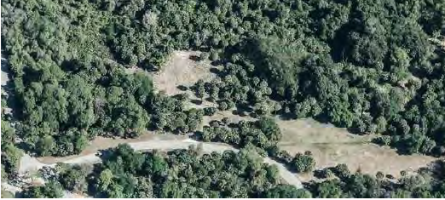
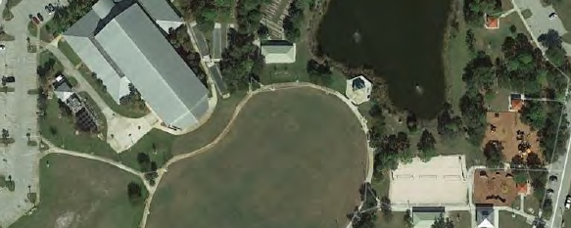
Chapter 3: Zoning Districts Sec. 3-5 Special Purpose
Environmentally Critical (EC)
Carried forward from transitional LDC
Preserves critical environmentally sensitive lands
Limited number and types of uses allowed (trails, hiking, fishing, canoeing, other passive outdoor activities, etc.)
Parks and Community Facilities (P)
Primarily public lands
Land for active and passive recreation, and for public buildings such as government offices, libraries, and schools
Notes:
MG NOTE: Parks and Community Facilities (also includes libraries), and Environmentally Critical.

Slide 19
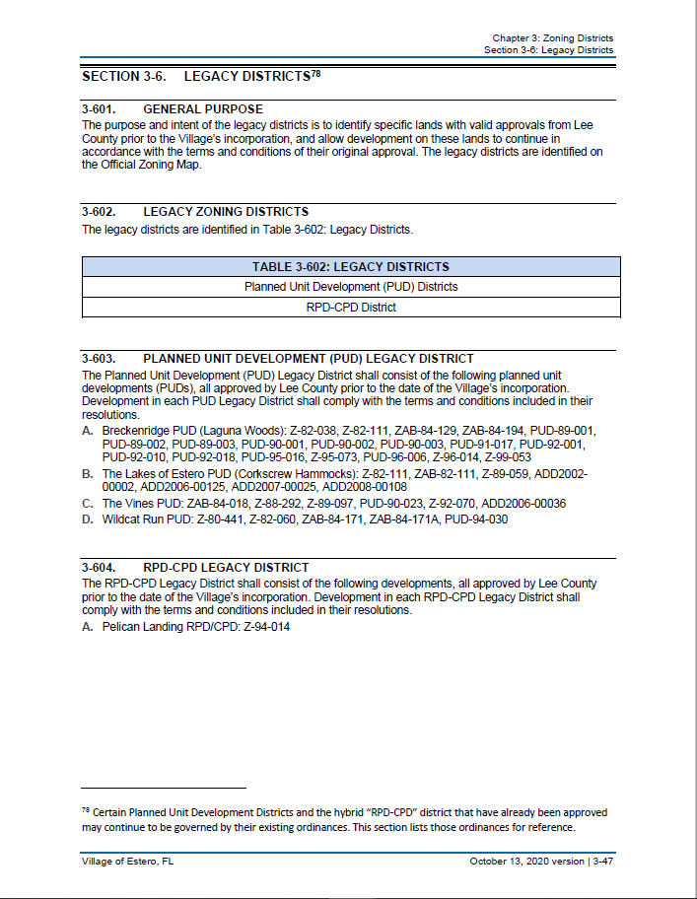
Chapter 3: Zoning Districts
Sec. 3-6 Legacy Districts
PUD and RPD-CPD Districts Recognizes older designations approved by Lee County; placed on Official Zoning Map, but not allowed as new districts
Existing PUDs and RPD-CPDs will be regulated by the ordinances adopted when they were established, or any amendments. The specific districts (and their ordinances) are listed in the section
3-603: incorporating Breckenridge, The Lakes of Estero, The Vines, and Wildcat Run PUDs
3-604: Incorporating Pelican Landing RPD/CPD

Slide 20
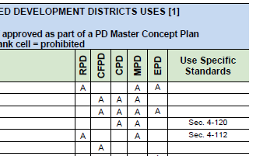
Chapter 3: Zoning Districts Sec. 3-7 Planned Development
Carried forward from transitional LDC, with refinements to implement Comprehensive Plan
All PD Districts must have a Master Concept Plan, a PD Phasing Plan (if phasing proposed) and a Pattern Book.
Underground utilities for new development

Slide 21
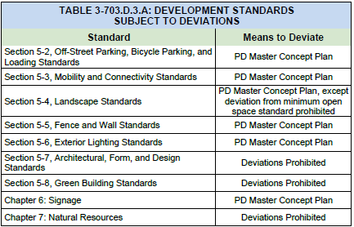
Chapter 3: Zoning Districts Sec. 3-7 Planned Development
Limited Deviation for Flexibility
Flexibility of standards to benefit development quality and design is a feature of planned developments.
Each district includes a table and additional language clearly describing what standards can be deviated from.

Slide 22
Chapter 3: Zoning Districts Sec. 3-7 Planned Development
Estero Planned Development (EPD)
Carries forward and refines the planned development created for the Village Center
Four “tiers” of development
Compact Communities Planned Development (CCPD)
Chapter 32 of the transitional LDC Incorporated by reference to allow its use in Tier 4 of EPD
Mixed Use Planned Development (MPD)
Encourages use mixing and pedestrian friendly development
Refined to allow development option for Transitional Mixed-Use future land use map designation from the Comprehensive Plan
Includes Bonus Density standards for lands designated Transitional Mixed Use in Plan

Slide 23
Chapter 3: Zoning Districts Sec. 3-8 Overlay
US 41 Overlay
Additional standards that limit parking in front of buildings to enhance the corridor
Airport Compatibility Overlay
Requires approval for height related to the region’s airport
Standards are required in all Lee County municipalities.
All overlay districts are carried forward from the transitional LDC
Corkscrew Road Overlay
Standards that ensure buildings face the street and frame this key corridor

Slide 24
Zoning Districts –Special Rezoning Rules
Special Rules Located in Chapter 4: Use Specific Standards are Important for Understanding the Districts
4-101: Uses Five Acres or Larger
Rezonings on lands that are five acres or more in area must be approved as a planned development (4-101.A)
Exceptions for: Village, County, or State Parks; Public Schools; Places of Worship; and Religious Facilities (4-101.B&C)
4-112: Commercial Development Location
All commercial development requiring a rezoning must be approved as a planned development (4-112.A)

Slide 25
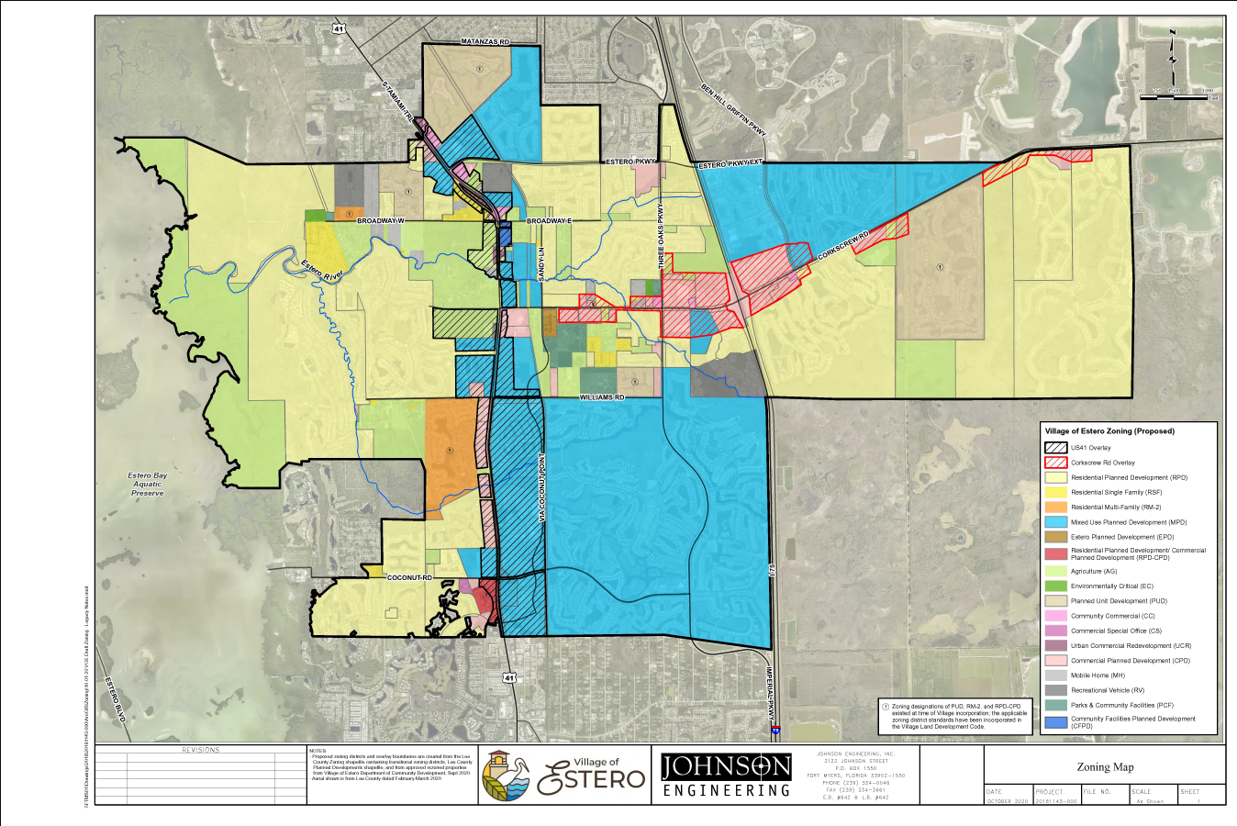
Zoning Districts –Proposed Official Zoning Map
Zoning Map applies the new district lineup to the Village.

Slide 26
Chapter 4: Use Specific Standards
Chapter 4 consolidates all use specific standards in one location in the LDC. When a use is listed in a use table in Chapter 3, there is often a cross reference to a use-specific standard in Chapter 4
Organizes standards by principal, accessory, and temporary use
Contains use specific standards that apply to all uses
Carries forward necessary alcoholic beverages language
Chapter 4: Use Specific Standards
Section 4-1 General Provisions
Section 4-2 Use Specific Standards for Principal Uses
Section 4-3 Use Specific Standards for Accessory Uses
Section 4-4 Temporary Uses and Structures
Section 4-5 Alcoholic Beverages

Slide 27
Chapter 4: Use Specific Standards - Sec. 4-1 Principal Uses
Notable Changes
Bar (4-107)
Only allowed with Council Review on lands designated Transitional Mixed-Use and Village Center in Plan
Brewpub or Micro-brewery, -winery, or –distillery (4-109)
New use
Limits on non-production (restaurant, tours, etc) area of the use
Requirement for 50% visibility or outdoor active space along primary facade
Prohibition of spill-over effects from production and distribution
Medical Marijuana Dispensaries (4-124)
Listed and specifically prohibited as per existing Village ordinances
Golf Course Conversion (4-121)
Conversion of a golf courses in or adjacent to planned development must be by planned development
Requires no adverse impacts and a master plan that includes “Preserve Areas”
Wireless Facilities (4-143)
Updated to reflect the changes to State law in 2017 that allow for small wireless facilities in the public right-of-way
Applicable to Village-controlled right-of-way (County and Utilities control their own)

Slide 28
Chapter 4: Use Specific Standards Sec. 4-2 Accessory Uses
Notable Changes
Electric Vehicles Charging Stations (4-202.E)
Establishes three “levels” and where they are allowed
Reserves EV charging-equipped spaces for EV vehicles
Limits interference with circulation or landscaping
Outdoor Storage (4-202.L)
For UCR, CC, and PDs-- prohibition of outdoor storage in front of the principal structure
Pickleball (4-202.M)
In conventional districts, only allowed by special exception, which requires public hearing
Standards limit outdoor lighting and noise so as not to create adverse impacts to adjacent properties.
Director may require mitigation measures to ensure adverse offsite impacts addressed.

Slide 29
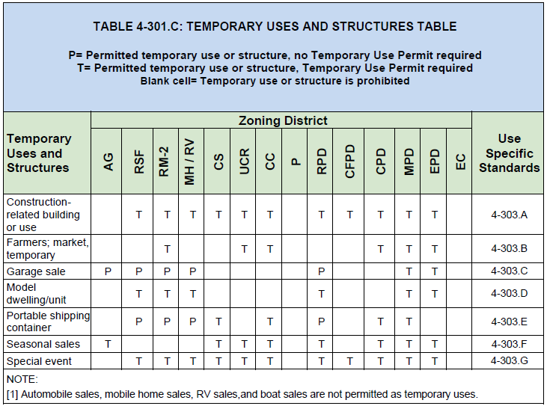
Chapter 4: Use Specific Standards Sec. 4-3 Temporary Uses
Farmers Market (4-303.B)
Replaces Oct. through April restriction. Markets may be open a max. of 60 days a year.
Markets must have established rules and an authorized manager.
Special Event(4-303.G)
Certain temporary uses not allowed
Automobile sales
Mobile home sales
RV sales
Boat sales

Slide 30
Use Type Definitions: Included in Chapter 10
Uses identified in the use tables are defined in Chapter 10.
Definitions will be included alphabetically with other definitions from the entire LDC in Chapter 10
The complete Chapter 10 will be a part of another module

Slide 31
Questions and Discussion
?

Slide 32
Reference
TALKING ABOUT LAND DEVELOPMENT CODES (LDCs)
The Lee County LDC
A document maintained by Lee County, that the County has continued to change since Estero incorporated. New changes to the Lee County LDC do not automatically change the transitional LDC. Development from before March 17, 2015 was built using the Lee County LDC.
The Transitional LDC or The Old LDC
Based on the Lee County LDC as it stood at the date of incorporation, with some amendments enacted by the Village Council over time, this document regulates development in the Village until the new LDC is adopted
The LDC or The New LDC
The proposed new document to regulate development in the Village
Module 1
Chapters 3 and 4 of the new LDC regulating Zoning Districts and Use Specific Standards
Review Draft
The New LDC draft presented today for comment and direction
Public Hearing Draft
A revised future draft modified based on feedback and cleared of drafting footnotes that will proceed through the adoption process.

