Slide 1
Lake Michigan Credit Union Estero
21910 S Tamiami Trail
Estero, FL

Slide 2
Exterior Paint Request
Add Two Exterior Windows
HVAC Screening

Slide 6
The lighter beige is SW2833 ROYCROFT VELLUM
The darker beige is SW2834 BIRDS EYE MAPLE
The blue is SW7616 BREEZY

Slide 7
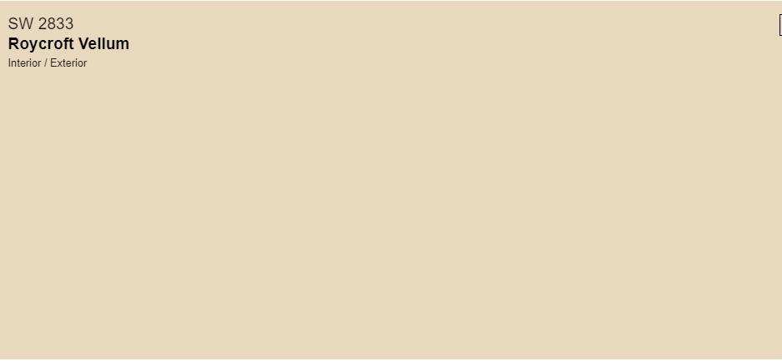

Slide 8
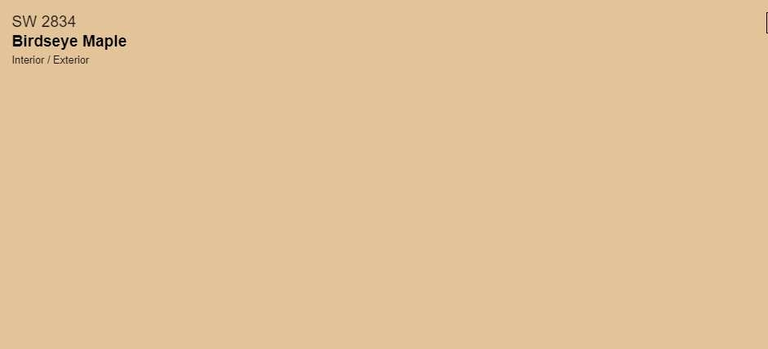

Slide 9
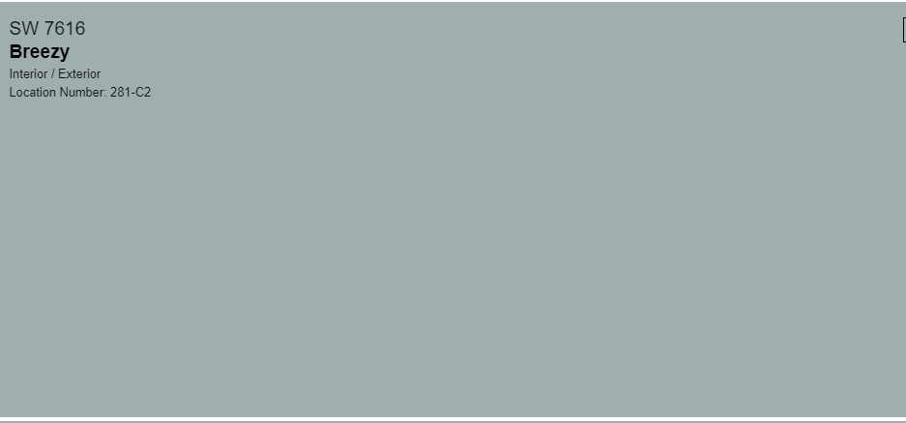

Slide 10
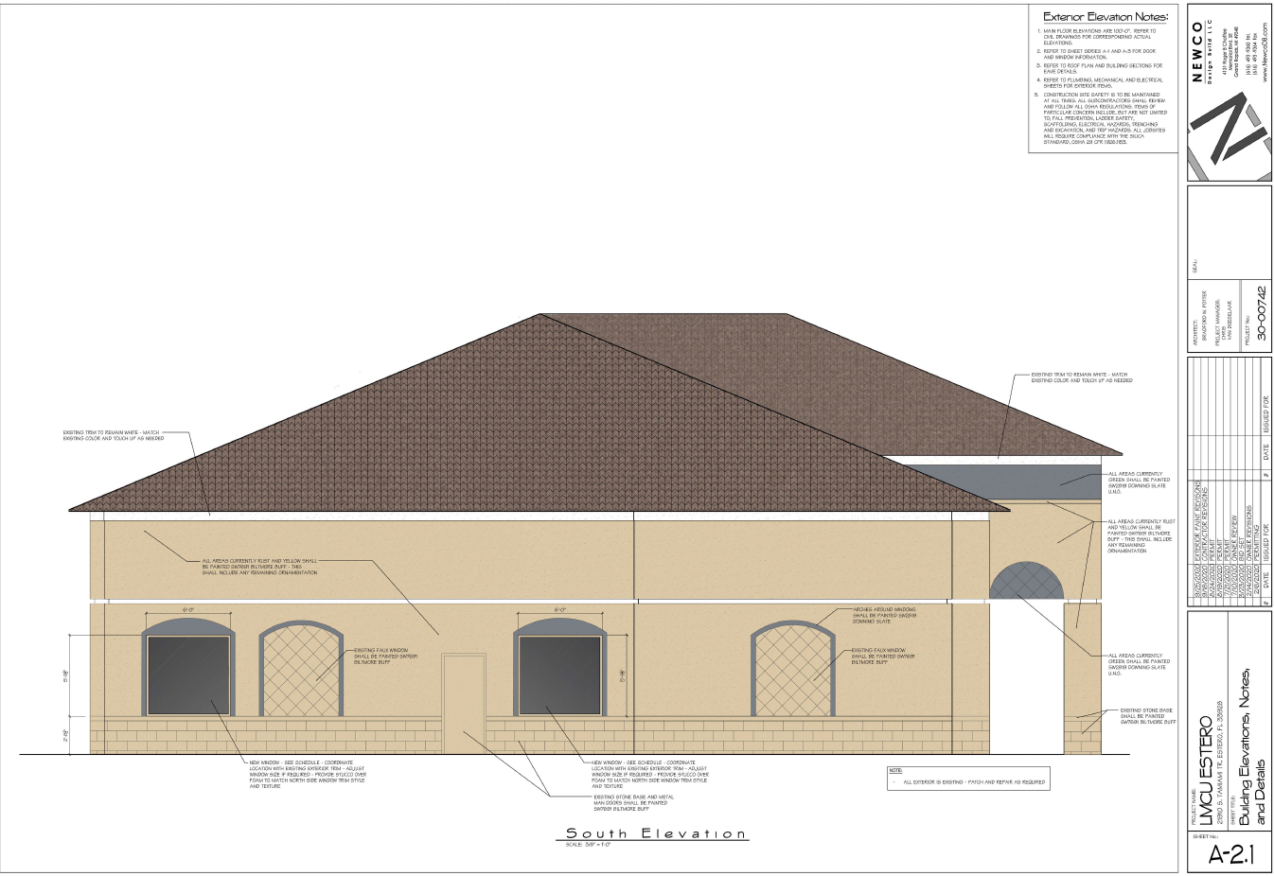
Windows to match existing style-arch top at South Elevation

Slide 11
HVAC Screening
The HVAC will be replaced like for like or replaced with a size as to be hidden be the parapet wall

